Slide 1
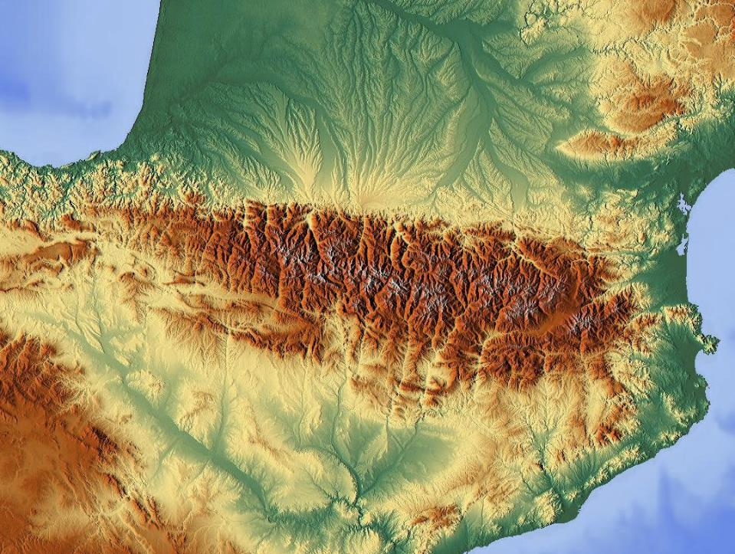
EART11100: Understanding the Earth
A dynamic Planet
An introduction to structural geology
Pyrenees
of France and Spain

Slide 2
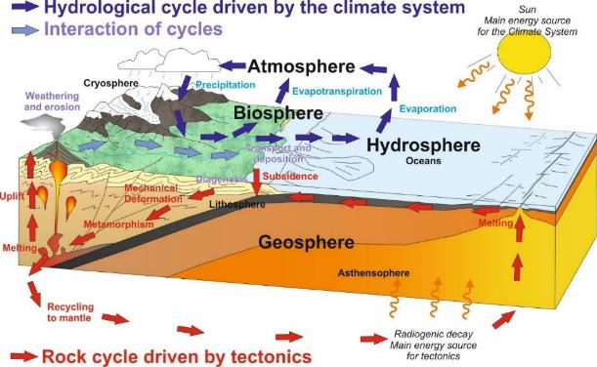
Intended learning outcomes
… you should be able to…
Describe the main rock structural features made in contractional, extensional and conservative tectonic regimes.

Slide 3
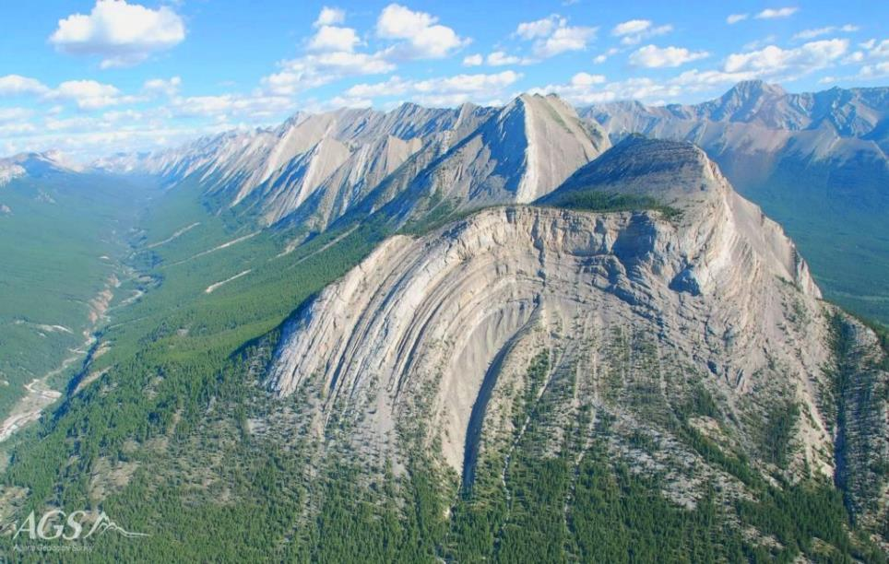
What is structural geology?
Structural geology is the study of the deformation in the lithosphere generated by stresses.
It’s a whole subject of its own, and deals with some of the most spectacular rocks!
Mount Head, Canadian Rockies

Slide 4
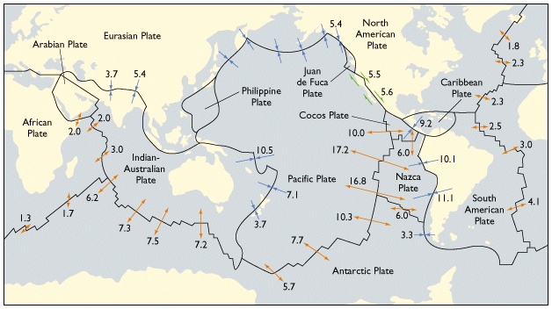
Why are rocks stressed?
If we look again at Earth’s current tectonic framework…
  → We can see that some parts of the Earths crust are being stretched (orange), compressed (blue), and are moving past one another (green).
  → These horizontal movements impart stresses of the rocks at the surface, as well as at depth.

Slide 5

Why are rocks stressed?
1. Load pressure: (= ‘lithostatic stress or confining stress):
Results from the weight of overlying rock.
Stress acts uniformly in every direction
(Analogous to the hydrostatic pressure beneath a head of water)

Slide 6
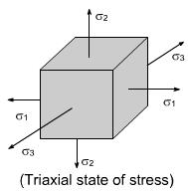
Why are rocks stressed?
2. Deviatoric (differential, or triaxial) stress
In some settings, stresses do not act uniformly on the rock (not simple lithostatic stress).
What could be the cause of non lithostatic stress?
Caused by lateral transmission of horizontal tectonic forces through the solid Earth’s crust (contraction or extension).
In the real 3D world (which always includes gravity), there will always be three principal, perpendicular stresses acting on an object
  →б₁ the maximum principal stress
  б₂ the intermediate principal stress
  б₃ the minimum principal stress

Slide 7
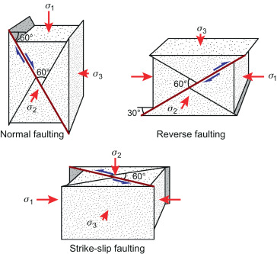
Faults
Fault are fracture surfaces, along which displacement has taken place.
Faults fall into three main categories….
  →Normal
  →Reverse, or “thrust”
  →Strike-slip…
According to the orientation of principal stresses in the triaxial state.
Anderson’s classification of tectonic stress

Slide 8
Faults
Dip-slip faults are those where movement has occurred along a dipping surface, and the two blocks have moved with a vertical component relative to the surface of the earth
Normal Fault
→Hangingwall is dowthrown
→Steep (~60º from horizontal)
→when б₁ is vertical, б₂ and б₃ are horizontal (extension)
→fault surface dips parallell to б₃
→Thins the crust

Slide 9
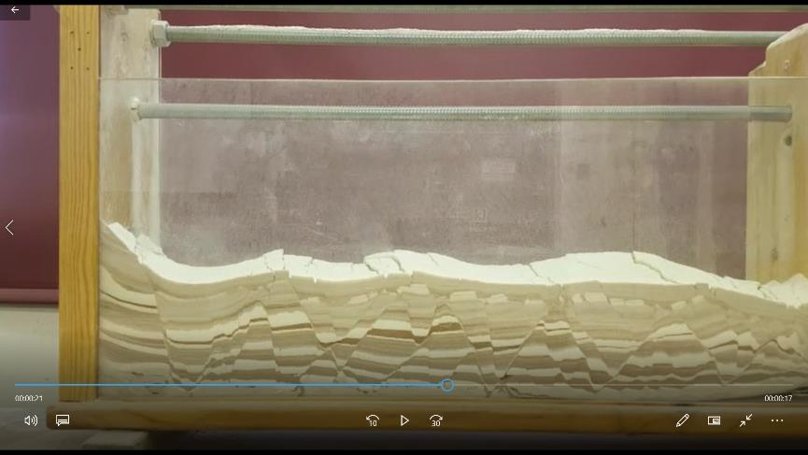
Faults
Extension video

Slide 10
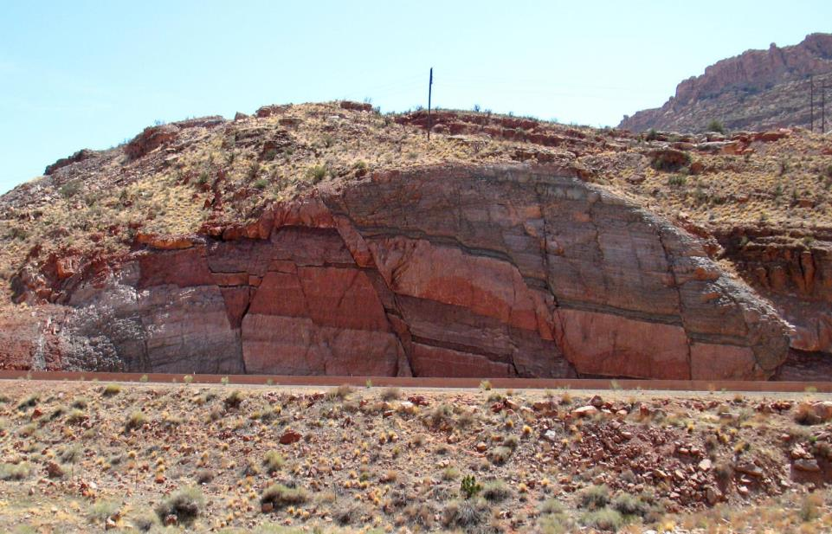
Faults
Normal faults

Slide 11
Faults
Dip-slip faults are those where movement has occurred along a dipping surface, and the two blocks have moved with a vertical component relative to the surface of the earth
Thrust or “reverse” fault
→Hangingwall is upthrown
→Low angle (~30º from horizontal_
→when б₃ is vertical, б₂ and б₁ are horizontal (compression)
→fault surface dips parallel to б₁
→Thickens crust

Slide 12
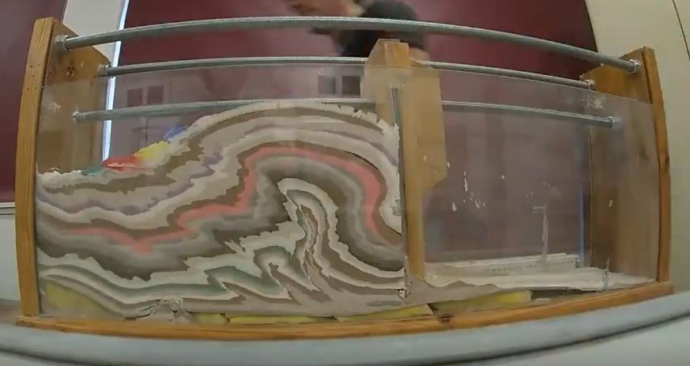
Faults
Compression video

Slide 13
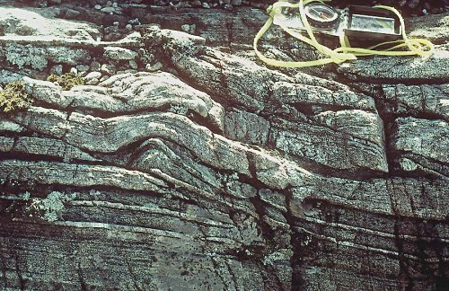
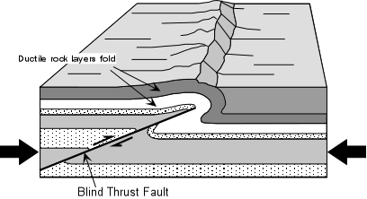
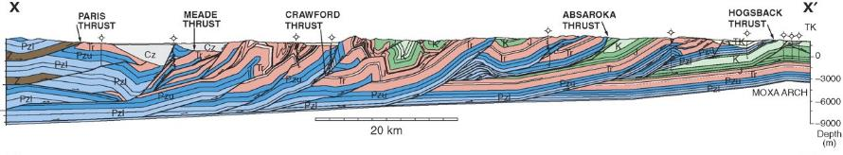
Faults
Thrusts, occurring in contractional zones, often occur with folds (“fold-thrust belts”).
Cross section through the Rocky Mountain fold-thrust belt

Slide 14
Faults
Strike-slip faults
Movement has occurred along a largely vertical surface, and the two blocks have moved with a horizontal component relative to the surface of the earth
→No hangingwall-footwall
→Vertical fault
→when б₂ is vertical, б₁ and б₃ are horizontal (shearing)
→No net change in crustal thickness

Slide 15
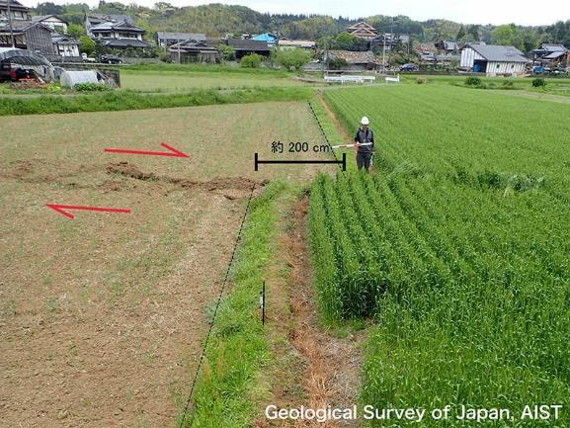
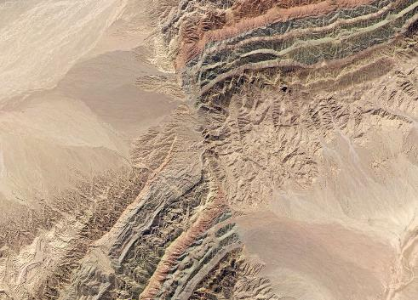
Faults
← Strike slip Fault, Japan
Strike slip Piqiang Fault, China →

Slide 16
Folds
Compression video

Slide 17
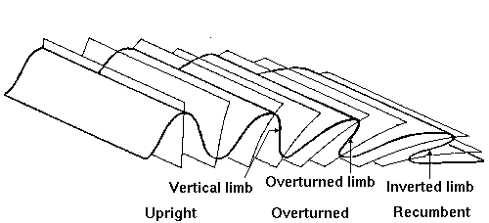
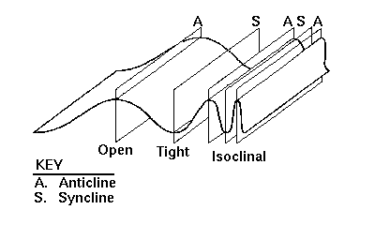
Folds
The majority of folding is caused by buckling: compression resulting in plastic deformation and shortening.
Compression zones include continental-continental collisions (orogens).
Increasing strain
Increasing strain
Folds are typically classified according to the orienation of the axial plane (=the plane the exactly bisects the interlimb angle)
And the “tightness” of the fold (=the interlimb angle)

Slide 18
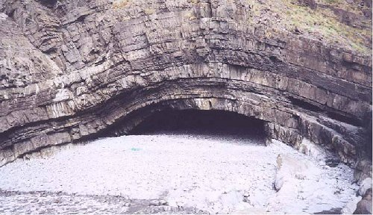
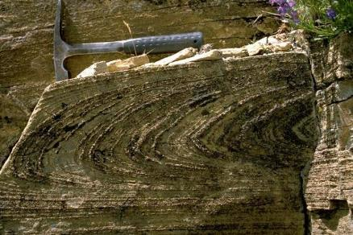
Folds
Vertical open fold
The classification works at all scales.
Fold axial plane and interlimb angle is a function of the stress-strain regime of the system.
Recumbent isoclinal fold

Slide 19
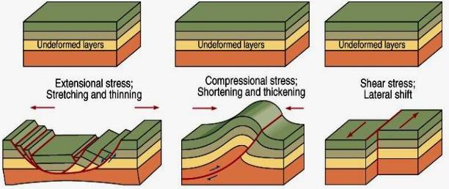
Summary
The Earth’s crust can be resolved into one of three end-member “Andersonian” tectonic states: Extension, Compression or Shearing.
Where stresses are sufficient to strain the crust,
  →Extension leads to normal faulting or stretching (thinning)
  →Compression leads to thrust faulting or folding (thickening)
  →Shearing leads to strike-slip faulting and fault-bending (no thickness change).

Slide 20
EART11100: Understanding the Earth
A dynamic Planet
Mechanisms for vertical crustal movement
Pyrenees
of France and Spain

Slide 21
Intended learning outcomes
… you should be able to…
explain why topography (and bathymetry) reflect an Earth's surface that is out-of-equilibrium
describe the three main mechanisms for vertical crustal movement.

Slide 22
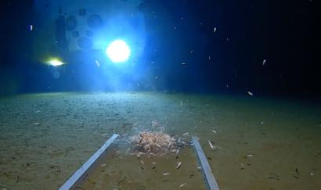
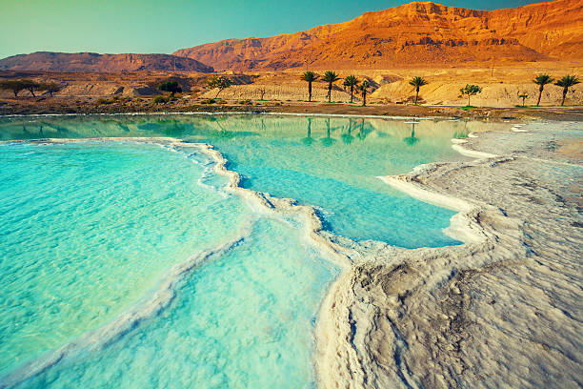
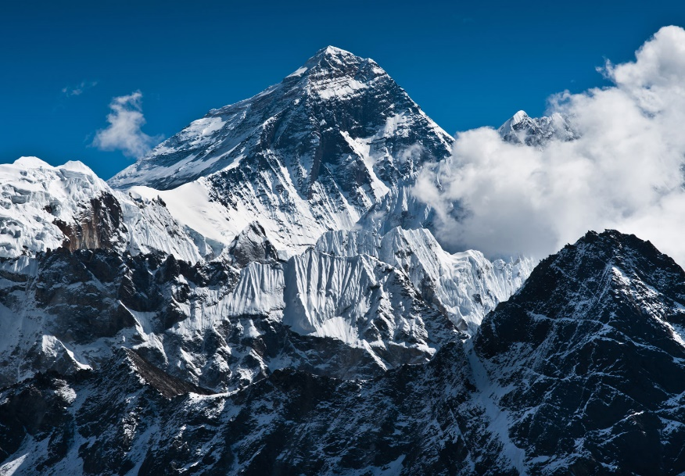
In this lecture…
Have you wondered why some areas of the Earth are high, and others low?
Mariana Trench: -10,994 m
Mount Everest: 8848 m ASL
Dead Sea shore: -413 m

Slide 23
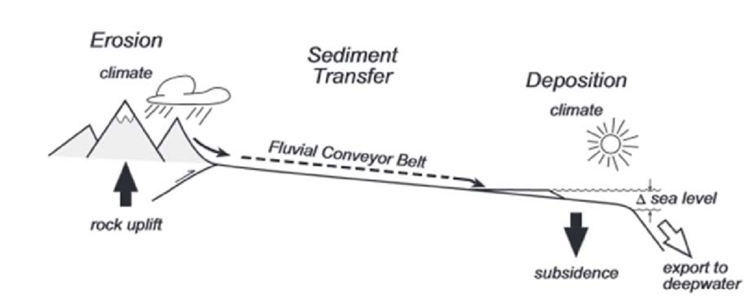
In this lecture…
The formation of these features on Earth’s Surface are primarily driven by tectonics….
…. but tectonics involves the horizontal movement of plates.
Vertical uplift forms high areas (mountains or hinterlands), and subsidence forms Sedimentary Basins.

Slide 24
In this lecture…
Uplift and subsidence can be thought of as in dynamic equilibrium:
→ as areas uplift they erode, forming clastic sediment
  → as areas subside they are filled-in with sediment
  ALL SEDIMENTARY ROCKS WERE DEPOSITED IN A SEDIMENTARY BASIN
(the entire sedimentary and fossil record of planet earth is contained here)!
“High” areas and “low” areas represent an out-of-equilibrium system.

Slide 25

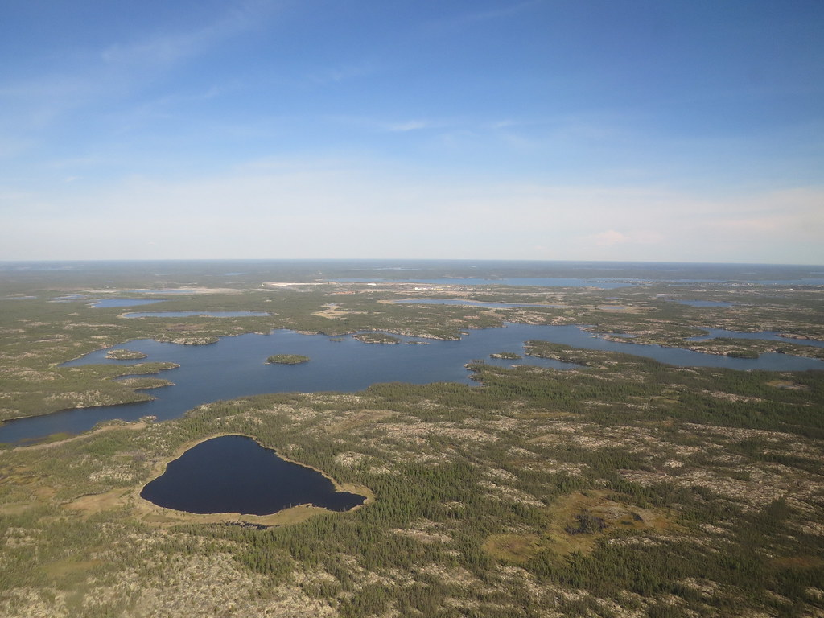
In this lecture…
Mariana Trench
Subsidence > deposition
What is the (long term) equilibrium balance in these examples?
Mount Everest
Uplift > erosion
Canadian shield
Uplift = erosion
Subsidence = deposition

Slide 26
In this lecture…
In order to understand why vertical crustal movements occur, we will look at the relationship between the lithosphere and the underlying mantle.
In the next part of the lecture we will use these underlying principles to understand vertical crustal movements in different Tectonic settings.

Slide 27
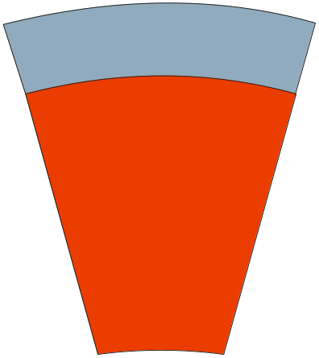
Behaviour of the lithosphere
Lithosphere
30-70 km thick
The lithosphere is rigid enough to comprise a number of relatively coherent plates, that move relative to each other as a result of asthenospheric deformation.
Continental - granitic 2.7g/cm³
Oceanic – basaltic 2.9g/cm³
MANTLE
down to 2900 km depth
Peridotite
>3.1 g/cm³
The asthenosphere is weak, and undergoes low rates of ductile deformation as a result of thermal gradients (convection).

Slide 28
Behaviour of the lithosphere
There are three main mechanisms for uplift and subsidence (basin formation)
But often all three mechanisms operate simultaneously
Isostasy – the consequences of changes in lithospheric thickness
Flexural loading (and unloading) of the lithosphere
Dynamic effects – effects of flow in the mantle

Slide 29
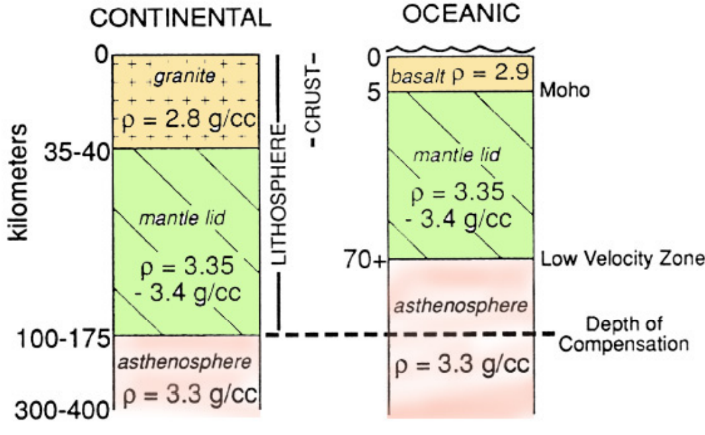
Behaviour of the lithosphere
1. Isostasy – the consequences of changes in lithospheric thickness
The lithosphere can be modelled as a less dense, rigid “blocks” of continent and ocean floating in a “fluid” mantle. I.e the mantle behaves as a Newtonian Fluid.

Slide 30
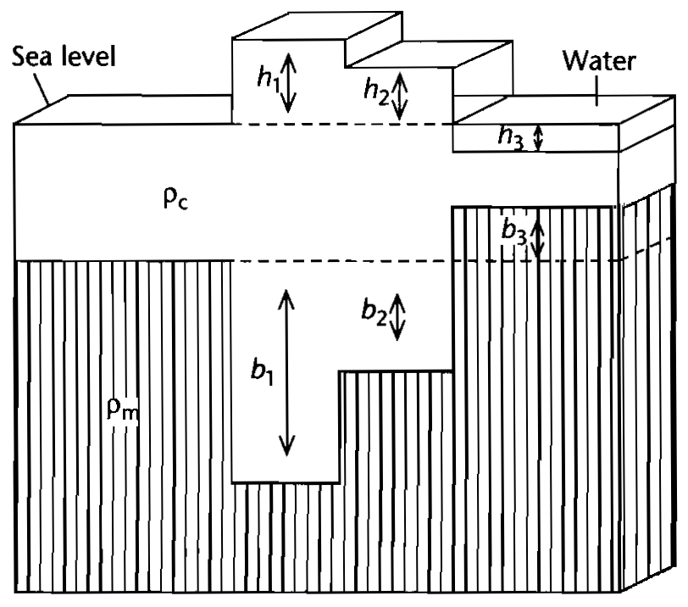
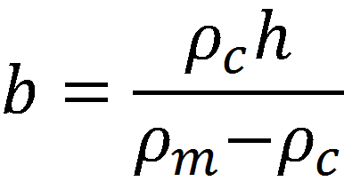
Behaviour of the lithosphere
Because “a body immersed in a fluid is buoyed up by a force equal to the weight [volume] of the displaced fluid”…
…changes in thickness of the floating blocks will result in changes in buoyant force acting upward upon it.
Where
b=thickness of the “root” of the mountain belt
h=the height (asl) of the mountain belt
ρ_{m} and ρ_{c} are the mantle and crustal densities
(“Airy” isostacy model)

Slide 31
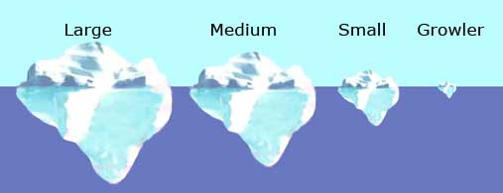
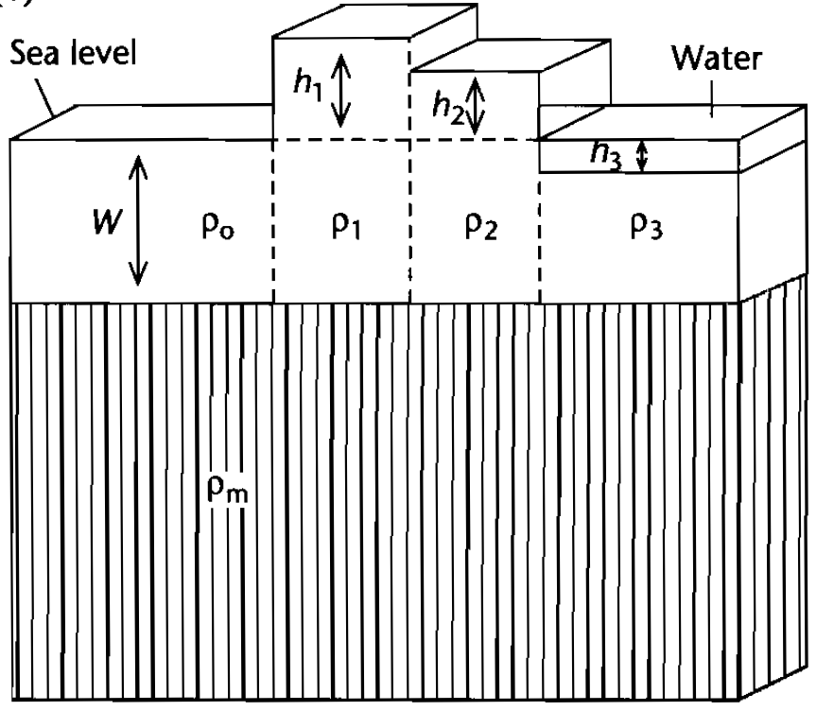
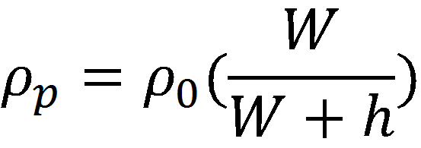
Behaviour of the lithosphere
What are the consequences for surface topography when changes in thickness occur to continental crust?
…changes in density of the floating blocks will result in changes in buoyant force acting upward upon it.
Where
ρ_{p}=density of lithospheric column, at a height, h, ASL
ρ₀=reference density for the lithosphere
W=compenation depth
(“Pratt” isostacy model)

Slide 32
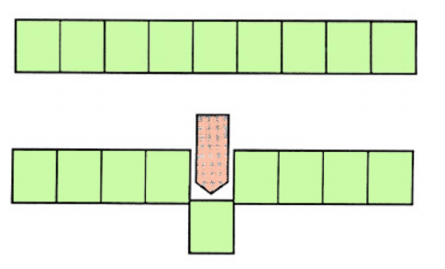
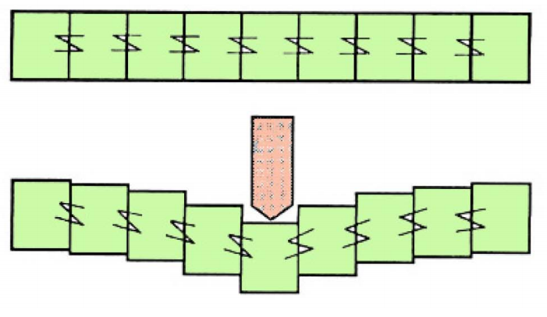
Behaviour of the lithosphere
2. Flexural loading (and unloading) of the lithosphere
In reality the lithospheric plates are not made up of discrete blocks that behave independently of eachother.
The lithosphere is rigid enough to resist changes in the load caused by thickening /thinning or density contrasts over wavelengths of < 100 km.
But changes in load over wavelengths of > 100 km are fully compensated for by elastic flexure of the lithosphere
“Local” isostacy
Flexure

Slide 33
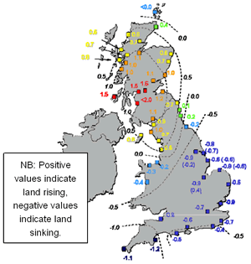
Behaviour of the lithosphere
Up to 10,000 years ago, Scotland was loaded with a major Ice Cap.
Now that it has melted, the “Airy Isostacy” model would have Scotland “rebounding” upwards”
But… southern England is also sinking downward in response to Scotland uplifting.
This is because the crust does not behave as individual blocks.
“Local” isostacy
Flexure

Slide 34
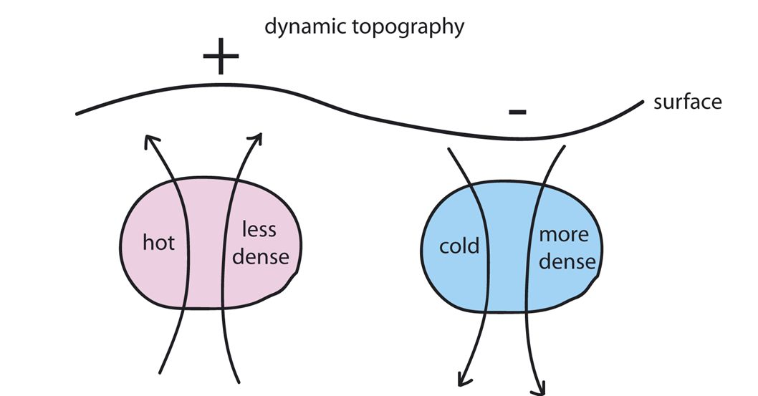
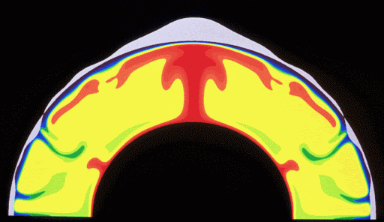
Behaviour of the lithosphere
3. Dynamic effects – effects of flow in the mantle
This is the easiest to understand….
Upwelling of hotter, less dense (and more voluminous) material in the mantle results in upward flexure of the overlying lithosphere
Sinking of cooler, more dense (and less voluminous) material results in downward withdrawal of the lithosphere.

Slide 35
EART11100: Understanding the Earth
A dynamic Planet
Vertical crustal movement in different tectonic settings
Pyrenees
of France and Spain

Slide 36
Intended learning outcomes
… you should be able to…
describe where isostacy, flexural loading, and dynamic effects happen in different plate tectonic settings, and
predict where topography and vertical crustal movement might be expected

Slide 37
Global tectonics
The transmission of horizontal tectonic forces (stress) through the lithopshere results in its mechanical deformation (strain).
Broadly…
Divergence: leads to thinning
Convergence leads to thickening
Conservatism leads to little change

Slide 38
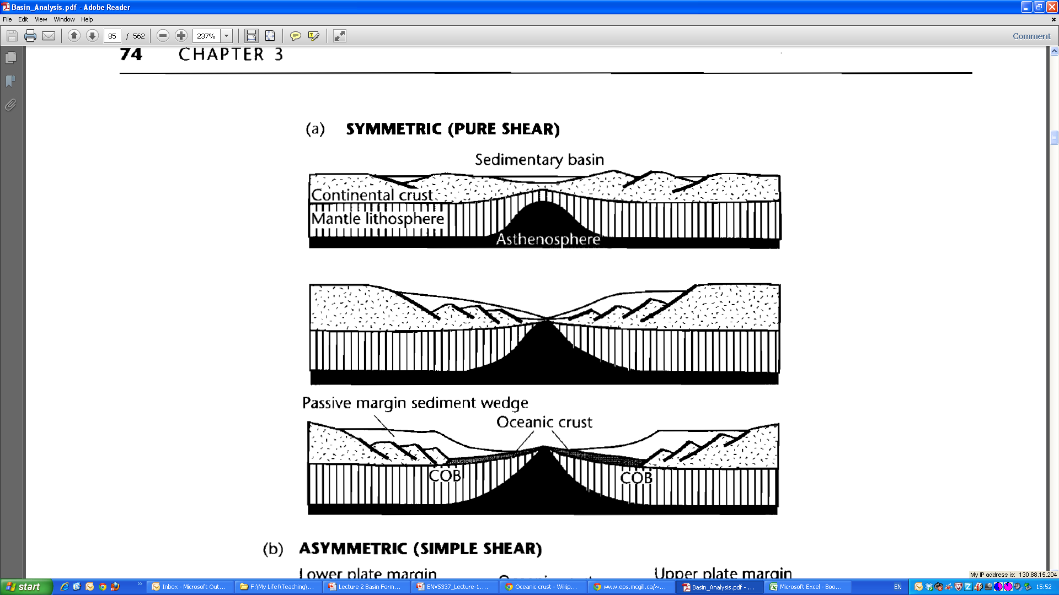
Vertical movement during extension
Extensional strain (stretching) of the lithosphere results in thinning of the lithosphere.
→Brittle normal faulting near surface
→ductile stretch of the lower lithosphere
Thinned crust leads to:
→basin formation (topographic low) - the isostatic response to thinning at the Earth’s surface (Airy isostacy).
→high heat flow
→volcanic activity
Two types of extension: “passive” and “active”.
Flanks uplift through isostatically

Slide 39
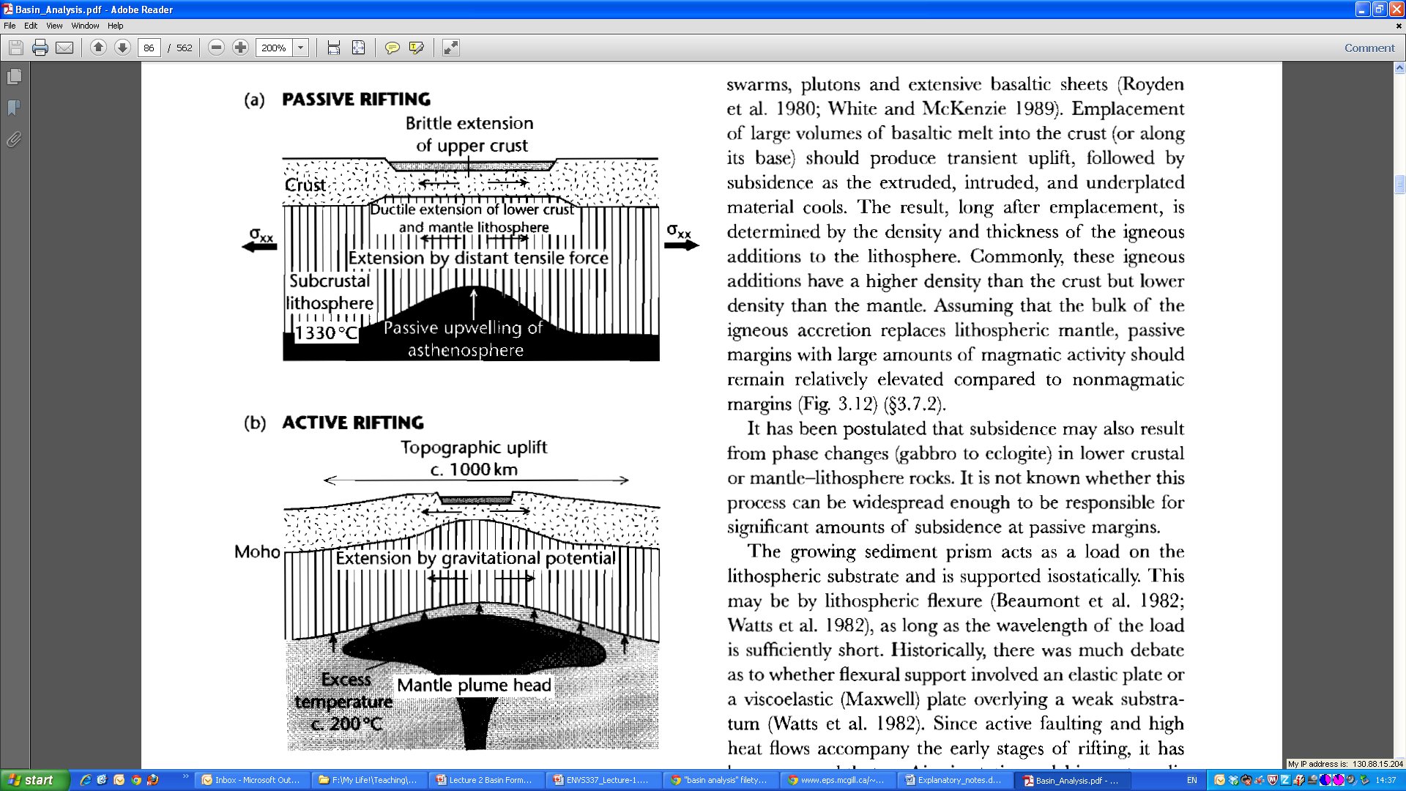
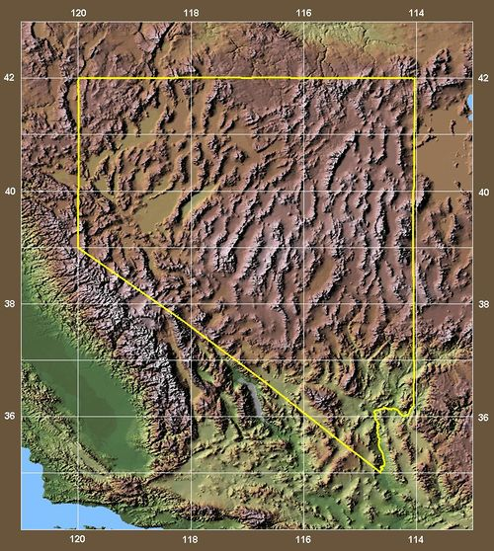
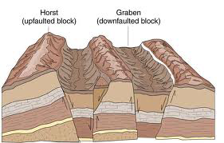
Vertical movement during extension
Regional extension causes rifting (thinning) of the lithosphere
Thinning causes decompression melting, and upwelling of the asthenosphere follows. E.g. Basin-and-range, USA.

Slide 40
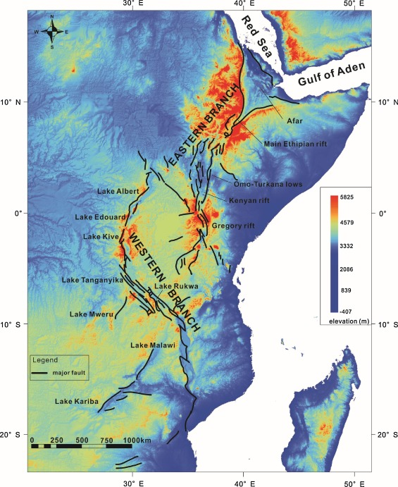
Vertical movement during extension
Hot mantle plume causes uplift of the lithosphere
Regional extension is caused by collapse under gravitational potential.
E.g. East African Rift

Slide 41
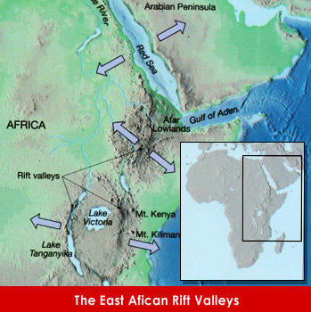
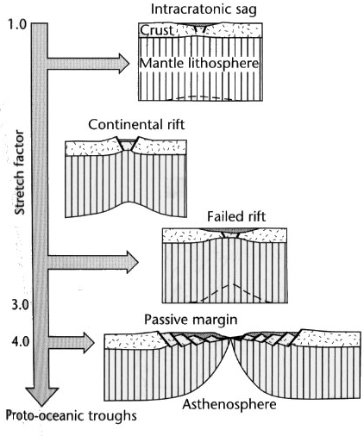
Vertical movement during extension
If strain rates are maintained, mantle upwelling leads to the formation of oceanic crust, and continental rifts evolve into Ocean basins.
Oceanic crust (basic) is denser (2.9) compared to continental crust (granitic, 2.7), so the crust sits lower in the asthenosphere (Pratt Isostacy)

Slide 42
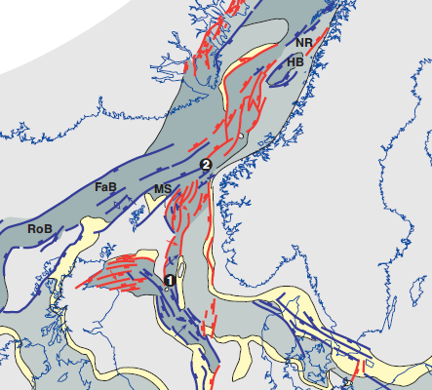
Vertical movement during extension
Failed rifts (“aulacogens”) are basins floored by oceanic crust, but where extensional strain has not been maintained, and the geothermal gradient has returned to (near) normal.
Greenland
Rifting in North Atlantic
Norway
Rifting in North Sea (failed rift)
UK
Jurassic (~150 Ma) of the North Sea

Slide 43

Vertical movement during extension
Continued extension leads to the formation of ocean crust proper.
E.g. all the World’s major Oceans.

Slide 44
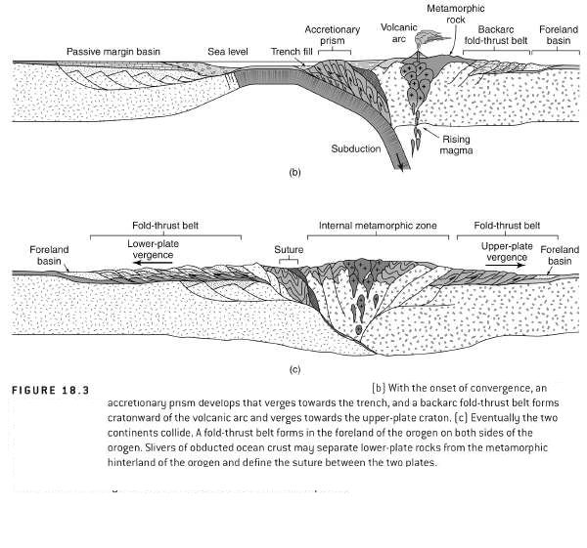
Vertical movement during contraction
During oceanic-oceanic and continental-oceanic collision, partial melting of the subducting slab, intrusion of melts into the overlying crust results in thickening
Accretionary prism of “scraped” sediment from the upper part of the ocean crust contributes too.
Results in thickened overlying slab
  → Surface uplift due to Airy Isostacy

Slide 45
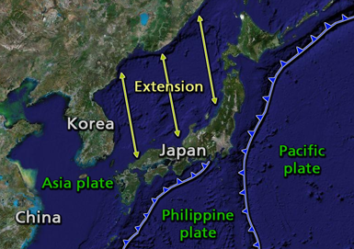
Vertical movement during contraction
The Japanese Archipelago is an example of this.
…but why is there extension behind the Arc (South China Sea), when this is a collisional setting?

Slide 46
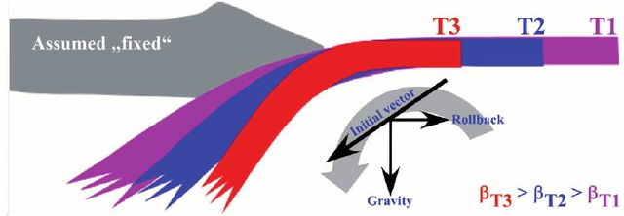
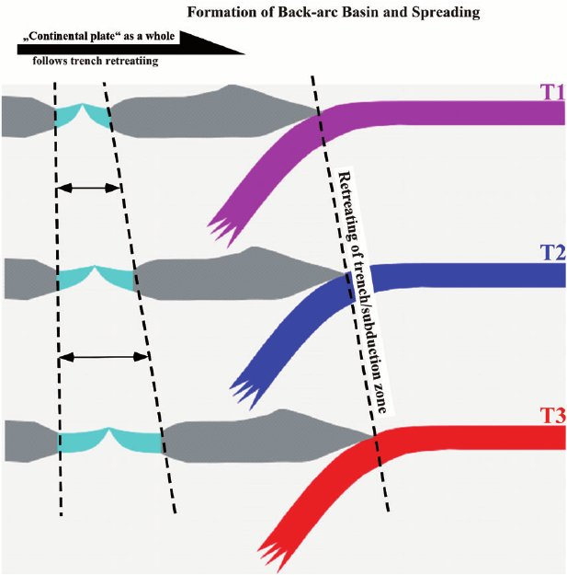
Vertical movement during contraction
Typically, the angle of subduction of the underlying crust typically steepens with time.
Leading to extension behind the Arc
  Back Arc Basins
→ Another mechanism for Passive Rifting.
So, counterintuitively, collision in Ocean-Ocean, and Ocean-Continental settings leads to Uplift, (Island, and Oceanic Arcs) and subsidence (Back Arc Basins)

Slide 47
Vertical movement during contraction
Eventual Closure of the ocean leads to continental-continental collision
One plate is “forced” under the other
Enormous deformation (faulting/folding/metamorphism and partial melting)
Results in thickening of the crust.

Slide 48
Vertical movement during contraction
France
The Pyrenees
Spain

Slide 49
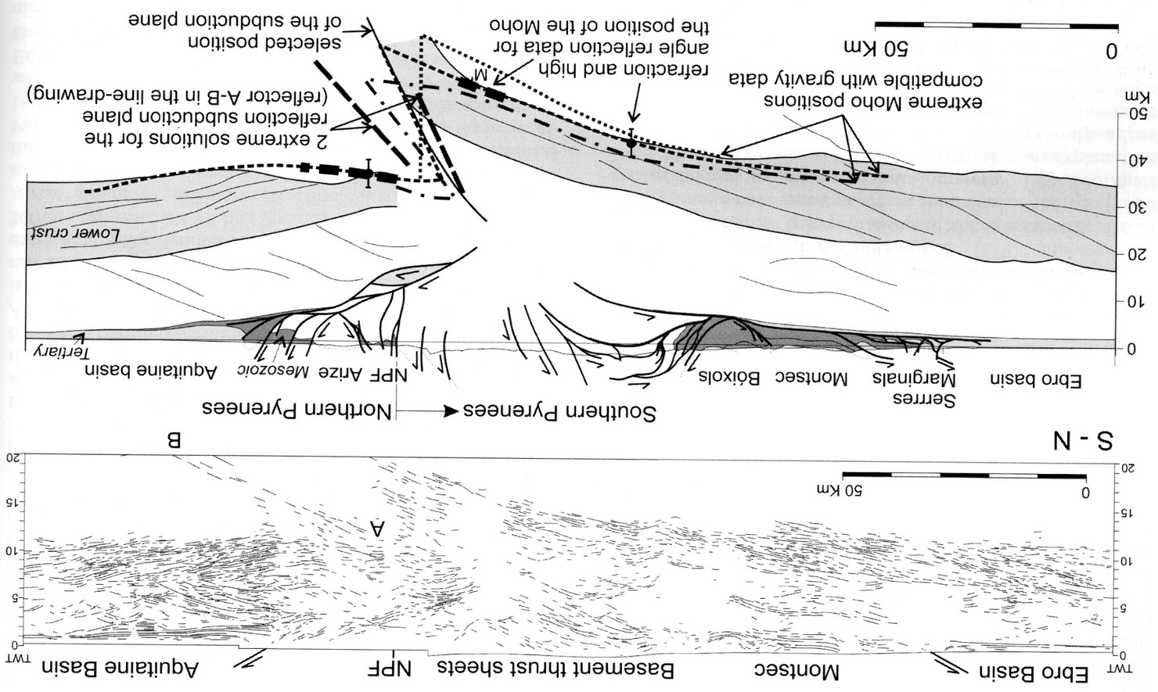
Vertical movement during contraction

Slide 50
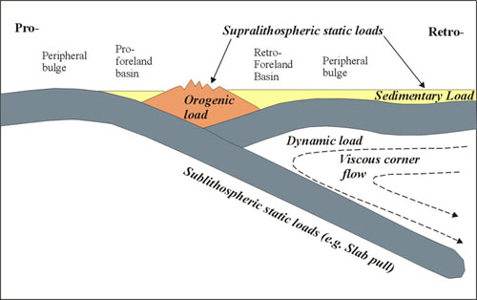

Vertical movement during contraction
Increase in load on lithosphere through thickening/density increase leads to long wavelength flexure of the lithosphere (regional isostacy).
→Leads to the formation of “foreland basins”.
→Most Mountain Belts have two foreland basis on either side of them
→Again, counterintuitively, continental-continental collision leads to uplift (Orogens) and subsidence (Foreland Basins)
Foreland basins receive sediment eroded from the uplifting Orogen.

Slide 51
Vertical movement during contraction

Slide 52

Vertical movement during contraction
Modern example: Gulf of Arabia Foreland Basin (continental-continental)
Thickening of the crust in the Zagros of Iran leads to the formation of a basin
Insufficient sediment supply to overfill the basin with sediment.
Eurasia
Arabia

Slide 53


Vertical movement during contraction
FORELAND BAINS:
Modern example: The Himalayan Foreland Basin (continental-continental)
Extensive topography developed through crustal thickening
Basin is mature, and “overfilled”

Slide 54


Vertical movement inconservative settings
Along strike-slip faults in conservative regimes, subsidence is typically caused by localised extension
→through transtension – a component of extension in a dominantly stike-slip setting
→along “double bends” – relays in faults.
SF
Pure shear
LA
Death Valley, California, is a basin formed through extension (transtension) at a strike-slip fault.
It’s lowest point is 86m below ASL

Slide 55

Vertical movement inconservative settings
Transpression
Transtensional
Basin formation is most commonly associated with transtensional structures
Sigmoidal in plan view, with steep margins, reflecting the vertical nature of strike-slip faults.
They usually subside very rapidly
But are volumetrically a minor component of global basins

